Slide 1
BRANDING | MARKETING | ADVERTISING
Case Study
Healthcare Clinics
Fast
Client Growth
Telemed Weight-Loss Clinic Grew by 145% in 90 days
BRANDING | MARKETING | ADVERTISING
We are more than a marketing agency—we are growth architects, dedicated to transforming businesses with scalable strategies that deliver measurable success. With a relentless focus on innovation and results, we empower our clients to thrive in competitive markets. In this case study, we were tasked with revitalizing a telemedicine weight loss clinic. Our mission: to attract and convert a highly targeted audience, differentiate the clinic from competitors, and create a compelling online experience that drives conversions.

Slide 2
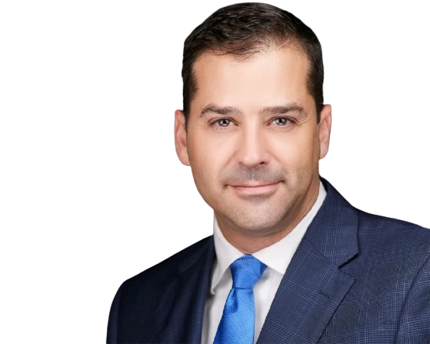
BRANDING | MARKETING | ADVERTISING
“Get Found • Get Trusted • Get Customers”
Our Approach
We've developed a proven marketing strategy that allows you to cut all money-draining ''no-return-costs' and zero in on what actually works.
This clever strategy allows you to hyper-target your audience away from competitors, direct them to your business, and create an environment with copy and design so powerful, that they are compelled to buy.
1
Executive Summary
Discover our diversified industry outlooks.
2
The Challenges
Highlighting various challenges faced by the brands and organizations.
3
The Solution
Our optimized custom solutions aligning the vision and outcomes.
4
The Result
Successful and highly optimized results and conversions.

Slide 3
BRANDING | MARKETING | ADVERTISING
“Get Found • Get Trusted • Get Customers”
Executive Summary
Branding | Marketing | Advertising
A telemedicine weight loss clinic sought to amplify its patient acquisition and optimize marketing expenditures. BMA analyzed the marketing strategy by the previous team and noticed various improvements that can be made. By implementing a strategic reallocation of its digital advertising budget towards high-demand services, the clinic achieved a 25.7% month-over-month increase in new members and a 33% reduction in cost per acquisition (CPA).
Our Client’s Need
Increased Patient Acquisition: 21.6% increase in new clients by attracting a wider audience and attract new patients.
Lowered Cost Per Acquisition: 37% reduction in CPA.

Slide 4
BRANDING | MARKETING | ADVERTISING
“Get Found • Get Trusted • Get Customers”
The Challenges
High Cost Per Acquisition
Inefficient targeting led to unsustainable marketing costs.
The healthcare clinic faced several key challenges:
Advertising Restrictions: Strict regulations limited the clinic to branded search campaigns, driving up CPAs and straining the budget.
Budget Optimization: Identifying wasted spend, the clinic prioritized advertising weight loss services to maximize ROI.
Missed Opportunities: Without segmentation, leads at different stages of the customer journey receive irrelevant messaging, leading to disengagement.
Low Conversions
Poor website design resulted in high bounce rates.
Underutilized Data
Existing patient data wasn’t leveraged for insights.

Slide 5
BRANDING | MARKETING | ADVERTISING
Client Success
“Get Found • Get Trusted • Get Customers”
Targeted Ad Campaigns:
The Solution
Focused 70% of the budget on high-demand weight loss services with precise targeting on Google and Facebook.
Website Optimization:
Improved CTAs, visuals, and added testimonials for a 22.5% conversion increase.
Predictive Analytics:
Implementing new flows by identified high-conversion audiences and optimizing ad spend.
Digital Marketing is the BEST way to unlock local growth.
Automated Multi-Channel Follow-Up:
We addressed these problems with the AIC initiative, a robust turnkey solution that offloads the burdens of marketing, appointment setting,
and patient follow-ups from clinic staff.
Use automated sequences to nurture leads, providing value through educational content like success stories, FAQs, and expert tips to get a better appointment rate.
AIC = Appointments In Clinic

Slide 6
BRANDING | MARKETING | ADVERTISING
“Get Found • Get Trusted • Get Customers”
The Results
By The Numbers
A significant 38.5% increase in booked appointments per month.
A drastic reduction in no-show rates to below 35%.
Lowered Cost Per Acquisition: 37% reduction in CPA.
21.6% increase in new clients.
A notable financial gain, with $80,000 new revenue in 90 days.

Slide 7
BRANDING | MARKETING | ADVERTISING
Thank You For Joining Us
Our Commitment
Our success is your success. As we grow, you grow. Together, we're building a stronger, healthier community, one patient at a time.

