Slide 1
BRANDING | MARKETING | ADVERTISING
Case Study
Healthcare Clinics
Scalable
Client Acquisition
Boosted Clinic Revenue From $2 to $18 Million
BRANDING | MARKETING | ADVERTISING
We are more than a marketing agency—we are growth architects, dedicated to transforming businesses with scalable strategies that deliver measurable success. With a relentless focus on innovation and results, we empower our clients to thrive in competitive markets. In this case study, discover how our expertise in website development, SEO, and local search optimization fueled a psychiatry group’s explosive revenue growth, from $2M to $18M.

Slide 2
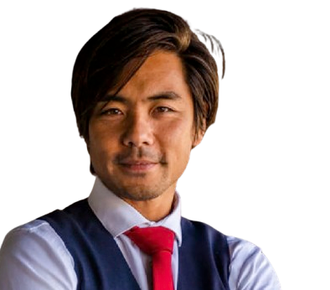
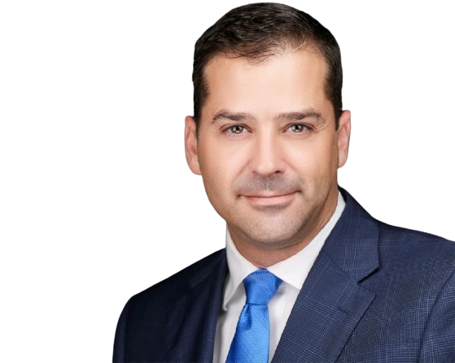
BRANDING | MARKETING | ADVERTISING
“Get Found • Get Trusted • Get Customers”
Our Approach
We implemented a strategic approach that focused on:
Robust Website Structure: Optimize website's architecture.
SEO Mastery: Target relevant keywords and implement best SEO practices.
Compelling Content Creation: High-quality blog posts and articles to educate and engage.
Google Business Profile Optimization: Dominate local search and build positive reviews.
1
Executive Summary
Discover our diversified industry outlooks.
2
The Challenges
Highlighting various challenges faced by the brands and organizations.
3
The Solution
Our optimized custom solutions aligning the vision and outcomes.
4
The Result
Successful and highly optimized results and conversions.

Slide 3
BRANDING | MARKETING | ADVERTISING
“Get Found • Get Trusted • Get Customers”
Executive Summary
Branding | Marketing | Advertising
This case study dives into the successful digital transformation of a psychiatry group seeking significant growth. Our team was tasked with developing and implementing a comprehensive digital marketing strategy to connect with potential patients and drive revenue.
By leveraging our expertise in SEO, content marketing, and Google Business Profile, we were able to dramatically reduce client acquisition costs, increase website traffic, and ultimately boost revenue by tenfold.
Need Patients
Patients are the revenue stream that sustains a clinic's operations.
Every patient represents a chance to improve someone's life and contribute to a healthier community.

Slide 4
BRANDING | MARKETING | ADVERTISING
“Get Found • Get Trusted • Get Customers”
Empty Chairs
The Challenges
Limited Online Visibility
The practice had a weak online presence and struggled to attract new patients.
Page 3 on Google
The psychiatry group faced several key challenges:
• They were stuck at a plateau of 50-60 patient visits per day.
Could not grow no matter what they tried.
• Current marketing efforts did not connect with potential clients.
They used a national company, who’s SEO/Content was the same for all clients.
• They had a 35% “no-show” rate.
Clients did not trust, did not value, and did not feel connected.
High Client Acquisition Costs:
Traditional marketing methods were expensive and inefficient.
$100+ client acquisition cost.
Scaling the Practice
The group aimed to expand its team and increase patient capacity but needed a sustainable growth strategy.

Slide 5
BRANDING | MARKETING | ADVERTISING
Client Success
“Get Found • Get Trusted • Get Customers”
Dominate 3-5 Mile Radius From Each Location:
The Solution
We forced Google to rank the practice #1, #2, & #3 for GBP.
From 25 calls per location to 800+ calls per location.
Increase Website Traffic:
Client committed to dominating SEO.
Ranked as a 25 Psychiatry Blog in the USA.
Reputation Management:
Took the client from 35 reviews with 3.2 rating to over 1,500 reviews with a rating over 4.8. Became the “trusted” choice.
Digital Marketing is the BEST way to unlock local growth.
Scale Marketing Efforts:
•SEO helps people find you online.
•Consistent blogs shows your expertise and builds trust.
•Google Business Profile is your digital storefront.
By investing in these tools, you're not just attracting new patients, you're building a thriving community of well-cared-for individuals.
Client was able to open multiple locations with a book of clients “in hand” and increased client lifetime value.

Slide 6
BRANDING | MARKETING | ADVERTISING
“Get Found • Get Trusted • Get Customers”
Clients Waiting To Be Seen
The Results
By The Numbers
Total Annual Revenue: $2 Million to $18 Million
Acquisition Cost: $100 -> $10
Lifetime Value of Client: Increased 30%
Ranked #1, #2, #3 in Google Business Profile
2,000+ calls per month
From 6 to 40+ Physicians
No Advertising Spend
From a small office to the largest psychiatry group in the area

Slide 7
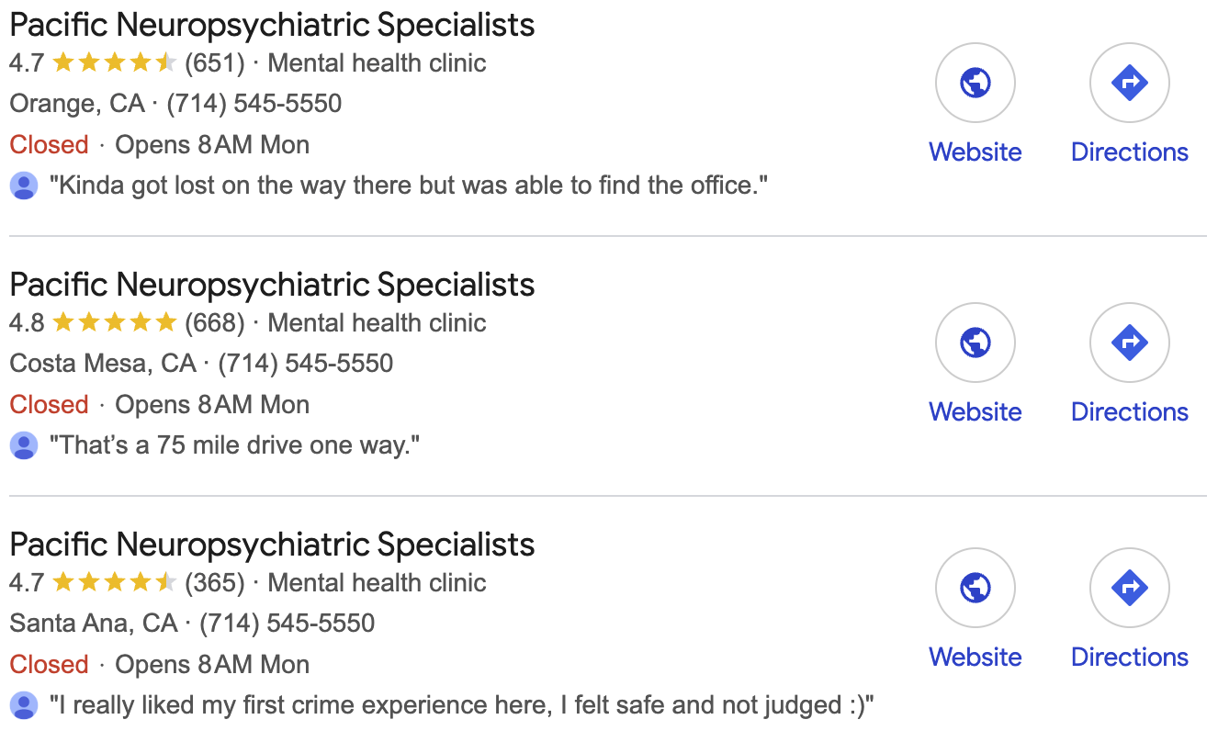
BRANDING | MARKETING | ADVERTISING
Thank You For Joining Us
Our Commitment
Traffic Increase
Our success is your success. As we grow, you grow. Together, we're building a stronger, healthier community, one patient at a time.
Keyword Increase

