Slide 1
BRANDING | MARKETING | ADVERTISING
Case Study
Healthcare Clinics
Fast
Client Growth
AIC Initiative Grew Revenue $102,000 in 55 Days!
BRANDING | MARKETING | ADVERTISING
We are more than a marketing agency—we are growth architects, dedicated to transforming businesses with scalable strategies that deliver measurable success. With a relentless focus on innovation and results, we empower our clients to thrive in competitive markets. In this case study, discover how hyper-targeting clients away from competition, directing them to their site, and creating an environment so with stunning design and great copy so compelling they had to use the clinic.
AIC = Appointments In Clinic

Slide 2
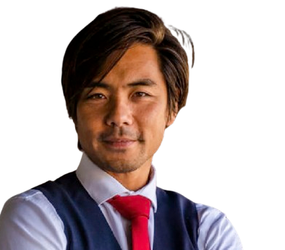
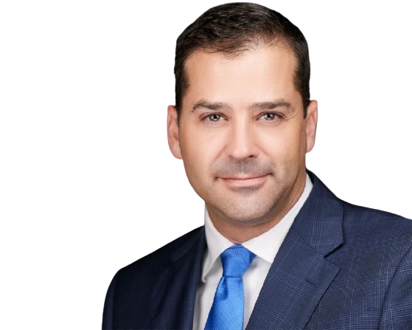
BRANDING | MARKETING | ADVERTISING
“Get Found • Get Trusted • Get Customers”
Our Approach
We've developed a proven marketing strategy that allows you to cut all money-draining ''no-return-costs' and zero in on what actually works.
This clever strategy allows you to hyper-target your audience away from competitors, direct them to your business, and create an environment with copy and design so powerful, that they are compelled to buy.
1
Executive Summary
Discover our diversified industry outlooks.
2
The Challenges
Highlighting various challenges faced by the brands and organizations.
3
The Solution
Our optimized custom solutions aligning the vision and outcomes.
4
The Result
Successful and highly optimized results and conversions.

Slide 3
BRANDING | MARKETING | ADVERTISING
“Get Found • Get Trusted • Get Customers”
Executive Summary
Branding | Marketing | Advertising
This case study aims to illustrate how effective digital marketing strategies can address the common challenges faced by many clinics: low appointment fill rates and high no-show rates. By highlighting the specific challenges experienced by the featured clinics, this case study will demonstrate how BMA's solutions can help healthcare providers optimize their operations, increase revenue, and improve patient satisfaction.
Our Client’s Need
Increased Patient Acquisition: Reach a wider audience and attract new patients.
Improved Patient Retention: Enhance patient engagement and loyalty.
Build Trust: Connect with Patients.

Slide 4
BRANDING | MARKETING | ADVERTISING
“Get Found • Get Trusted • Get Customers”
The Challenges
Limited Online Visibility
The practice had a weak online presence and struggled to attract new patients.
The healthcare clinic faced several key challenges:
Outdated Online Presence: Their website was a relic of the past, failing to engage potential clients and hindering growth.
Inefficient Scheduling: Manual appointment setting and follow-up processes were time-consuming and prone to errors.
High No-Show Rates: A significant 25% of scheduled appointments went unfilled, leading to lost revenue and operational inefficiencies.
Eroding Patient Trust: Lack of consistent communication and personalized experiences resulted in declining patient trust and loyalty.
No Connection
Hard for patients to schedule online, high no-show rates.
Lack of Patient Trust
Consistent communication and personalized experience is key.

Slide 5
BRANDING | MARKETING | ADVERTISING
Client Success
“Get Found • Get Trusted • Get Customers”
Dominate 3-5 Mile Radius From Each Location:
The Solution
A significant 40% increase in booked appointments per month.
A drastic reduction in no-show rates to below 35%.
Appointments Kept:
A drastic reduction in no-show rates to below 35%.
Fast Revenue Growth:
A notable financial gain, with $102,000 accumulated in revenue in under two months.
Digital Marketing is the BEST way to unlock local growth.
Built Client Trust and Referrals:
We addressed these problems with their AIC initiative, a robust turnkey solution that offloads the burdens of marketing, appointment setting,
and patient follow-ups from clinic staff.
Enhanced patient satisfaction, noted through improved service ratings.
AIC = Appointments In Clinic

Slide 6
BRANDING | MARKETING | ADVERTISING
“Get Found • Get Trusted • Get Customers”
Trust Builds Healthcare Practices
The Results
By The Numbers
A significant 40% increase in booked appointments per month.
A drastic reduction in no-show rates to below 35%.
Enhanced patient satisfaction, noted through improved service ratings.
A notable financial gain, with $102,000 accumulated in revenue in under two months.

Slide 7
BRANDING | MARKETING | ADVERTISING
Thank You For Joining Us
Our Commitment
Our success is your success. As we grow, you grow. Together, we're building a stronger, healthier community, one patient at a time.

